Slide 1
The Number System - Binary, Hex Numbers, ASCII Code, And Conversions
Learning Modern Number Systems The Easy Way…
Chapter: 9

Slide 2
Why Numbering Systems?
Digital systems only understand 0 and 1.
The World needs a unique/standard representation of values
Characters are converted to numbers.
Digits are represented based on the position of the values.
Different platforms use different numbering systems.
Four types of numbering:
Binary
Octal
Hexadecimal
Decimal

Slide 3
Computer Units Of Measurement
Bits denote smallest unit of representation; 0 and 1.
Byte combination of 8 bits.
Other units of measurement are:
Unit | Equivalent
1 kilobyte (KB) | 1,024 bytes
1 megabyte (MB) | 1,048,576 bytes
1 gigabyte (GB) | 1,073,741,824 bytes
1 terabyte (TB) | 1,099,511,627,776 bytes
1 petabyte (PB) | 1,125,899,906,842,624 bytes

Slide 4
Numbering System
Numbering System | Base | Digits
Decimal | 10 | 0,1,2,3,4,5,6,7,8,9
Binary | 2 | 0,1
Octal | 8 | 0,1,2,3,4,5,6,7
Hexadecimal | 16 | 0,1,2,3,4,5,6,7,8,9,A,B,C,D,E,F

Slide 5
Binary Number
Number | Binary Number
1 | 1
2 | 10
3 | 11
4 | 100
5 | 101
6 | 110
7 | 111
8 | 1000
9 | 1001
10 | 1010
Follows base-2 numeral system.
Base-2 means only two digits.
The Radix of the binary number is 2.
Consists 0 and 1 only.
Used in logic circuits.
The most commonly used numbering system.
Each digit is referred to as a bit.

Slide 6
Hexadecimal Number
Number | Hexadecimal
0 | 0
1 | 1
2 | 2
3 | 3
4 | 4
5 | 5
6 | 6
7 | 7
8 | 8
9 | 9
10 | A
11 | B
12 | C
13 | D
14 | E
15 | F
Also called hex numbers.
Used to represent long strings.
Groups 4 binary bits for binary notation.
Follows base-16 numeral system.
Numbers 0 to 9 represented as it is.
Numbers 10 to 15 represented using A to F.

Slide 7
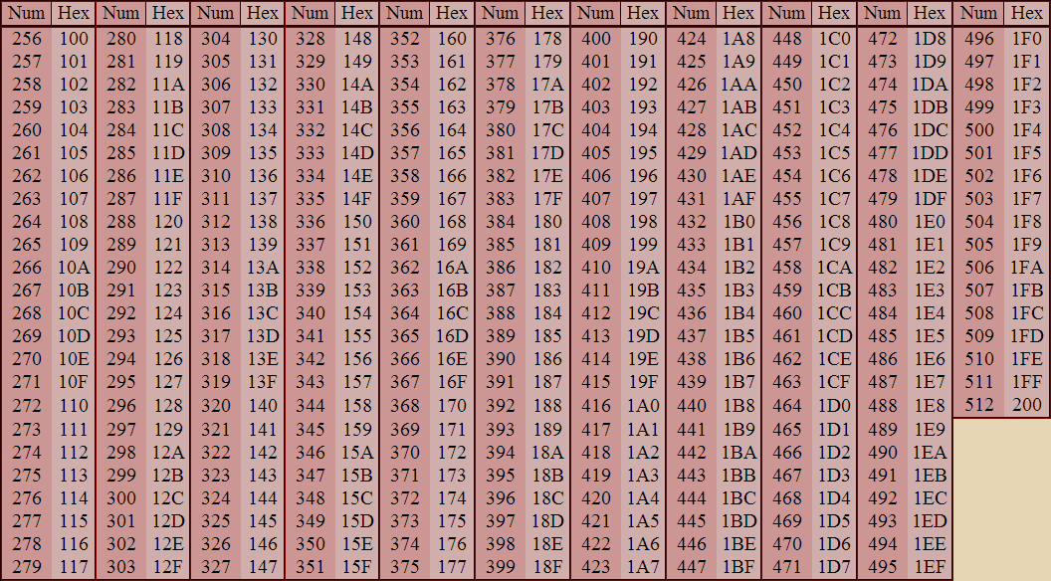
Hexadecimal Notation From 256 To 512

Slide 8
ASCII Code
American Standard Code for Information Interchange.
Uses characters in 256 slots in an 8-bit code.
Only 128 characters standardized out of 256.
Developed for American language.
Lacks symbols for European languages.

Slide 9
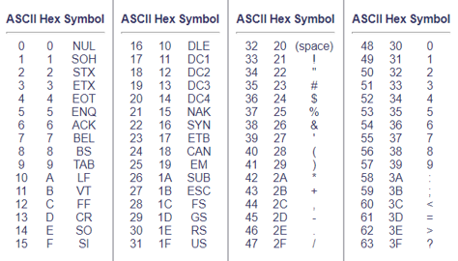
ASCII

Slide 10
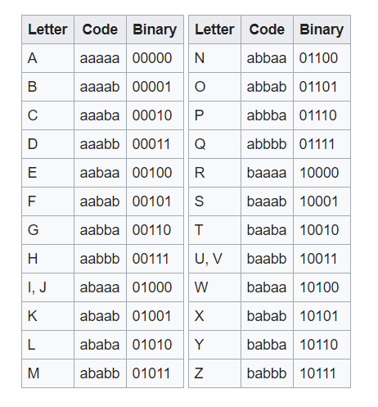
Bacon Code
Predecessor of ASCII code.
Developed by Francis Bacon.
Formed in 1626.
Used bilateral steganography.
Uses combination of a and b only.

Slide 11
Why Conversions?
Conversions required for compatibility in different platforms.
Manual and automatic numbering system conversion possible.
Types of conversions are:
Binary to hex number
Hex number to binary
Binary to ASCII code
Hex number to ASCII code
ASCII code to binary
ASCII code to hex number

Slide 12
Binary To Hex Conversion
From rightmost side, divide binary in group of four bits.
Blank spaces assigned zeros at left side.
Hex numbers written for each group.
Concatenate all digits for final hexadecimal.
100010100101 in binary is 8A5₁₆.

Slide 13
Hexadecimal To Binary Conversion
Assign binary equivalent of each hexadecimal.
Each binary should be group of 4 bits.
Add zeros at least significant positions.
Concatenate the digits.
Final result will be binary.
3AB2₁₆ will be 0011101010110010 in binary.

Slide 14
Binary To ASCII Code
At first, validate binary digits.
Format the binary before processing.
Divide binary into octets.
Replace octet with decimals.
Using ASCII table, replace decimals with ASCII code.
010000010100001001000011₂ is ABC in ASCII.

Slide 15
Hexadecimal To ASCII Code
Split the hex numbers.
Make it into pairs.
Fill blanks with zeros in right side.
Using table, assign ASCII code to each hexadecimal.
52696368 is Rich in ASCII code.

Slide 16
ASCII To Binary Number
Take one character at a time.
Assign decimal value for character using table.
Convert decimal to binary.
Continue until last character is converted.
Concatenate all binary numbers.
Character Pla is 01010000 01101100 01100001 in binary.

Slide 17
ASCII To Hexadecimal
Take each ASCII code.
Get decimal equivalent of each ASCII code.
Convert decimal into hexadecimal.
Repeat until all ASCII converted to hexadecimal.
Concatenate final outputs.
Character A is 4116 in hexadecimal.

Slide 18
Final Words
Humans use base-10 number system.
Electronic system understand base-2 numeral system.
Newer numbering system may be developed.
Computer understand 0 and 1.
Binary number is the foundation.
Online resources available for conversions available.

Slide 19
Food For Thought
A forensic investigator came across encoded message.
Message was in hexadecimal.
1E2 was the code.
Convert hex number into decimal.
On conversion value will be 482.
1E2₁₆ = 1*16²+14*16¹+2*16⁰ = 256+224+2 = 482₁₀

